Slide 1
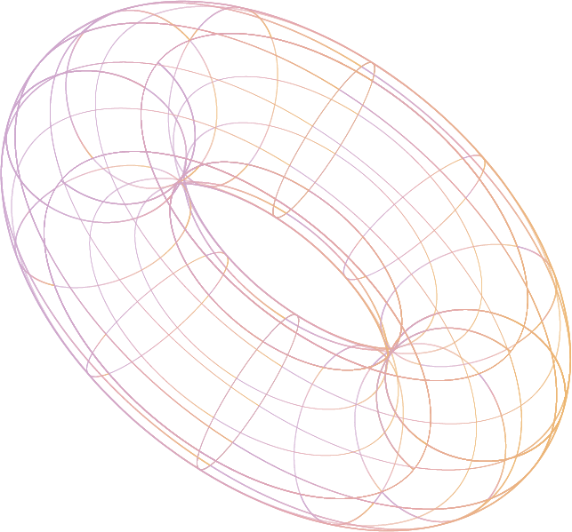

Conversion Crew 5D’s 2D to 3D Converter
By: Maisha Iqbal, Takumi Fukuzawa, Robert Yamasaki, Glenn Todd, and Sadman Islam
Notes:
maisha

Slide 2
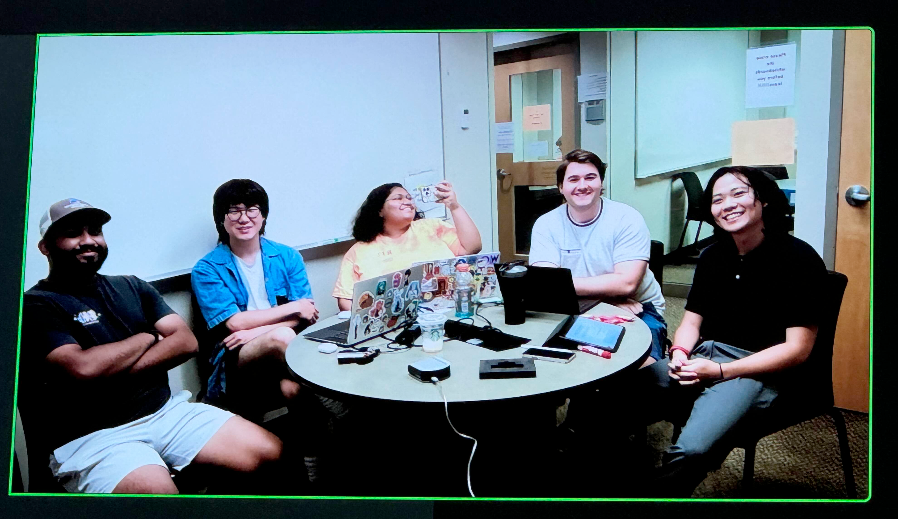
Introduction
Hi everyone!
We’re graduating seniors in Software Engineering at the Rochester Institute of Technology and this is our senior capstone project!
We’re excited to share what we’ve been working on with everyone!
https://en.wikipedia.org/wiki/Polygon_mesh
https://davidneat.wordpress.com/technical-drawing/some-of-the-principles-of-technical-drawing-simply-illustrated-part-1/
Notes:
maisha

Slide 3



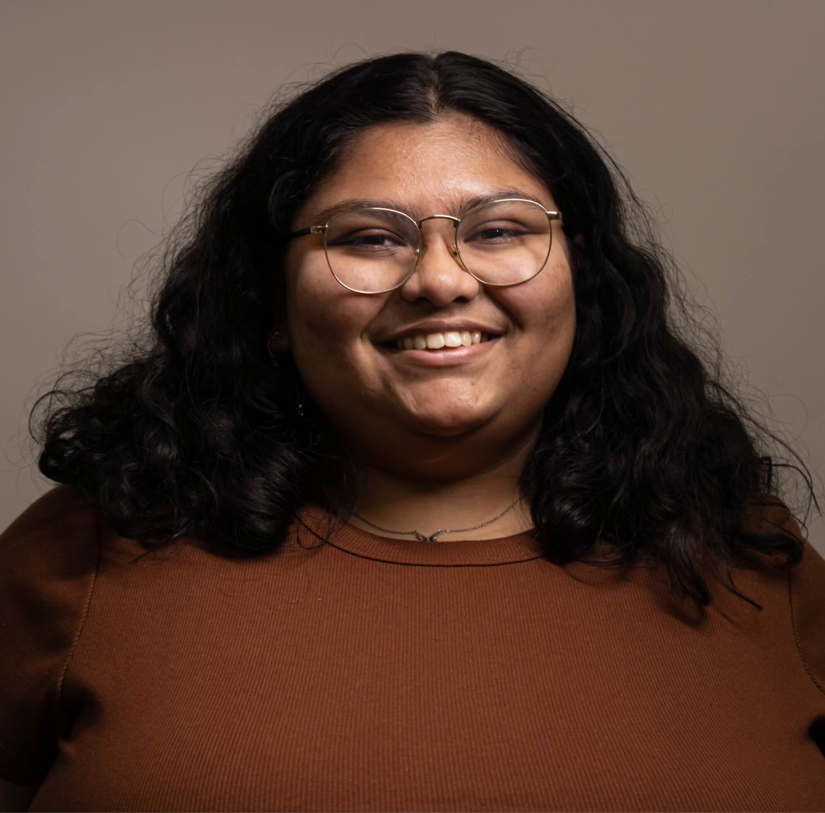
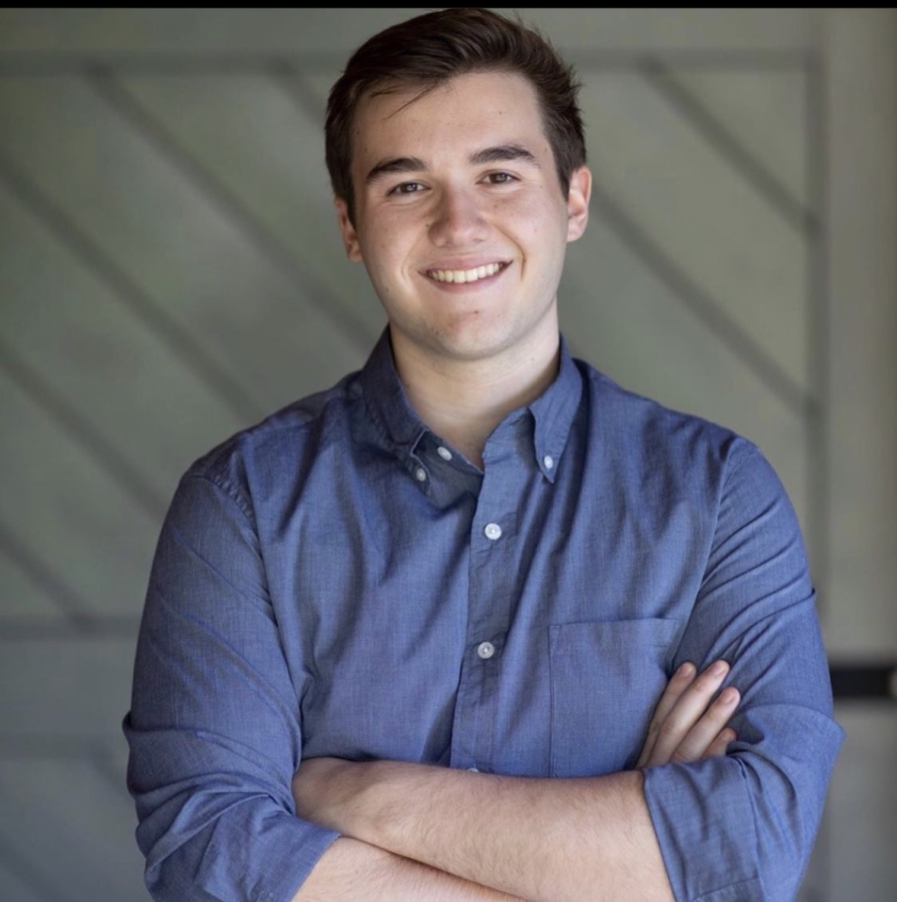
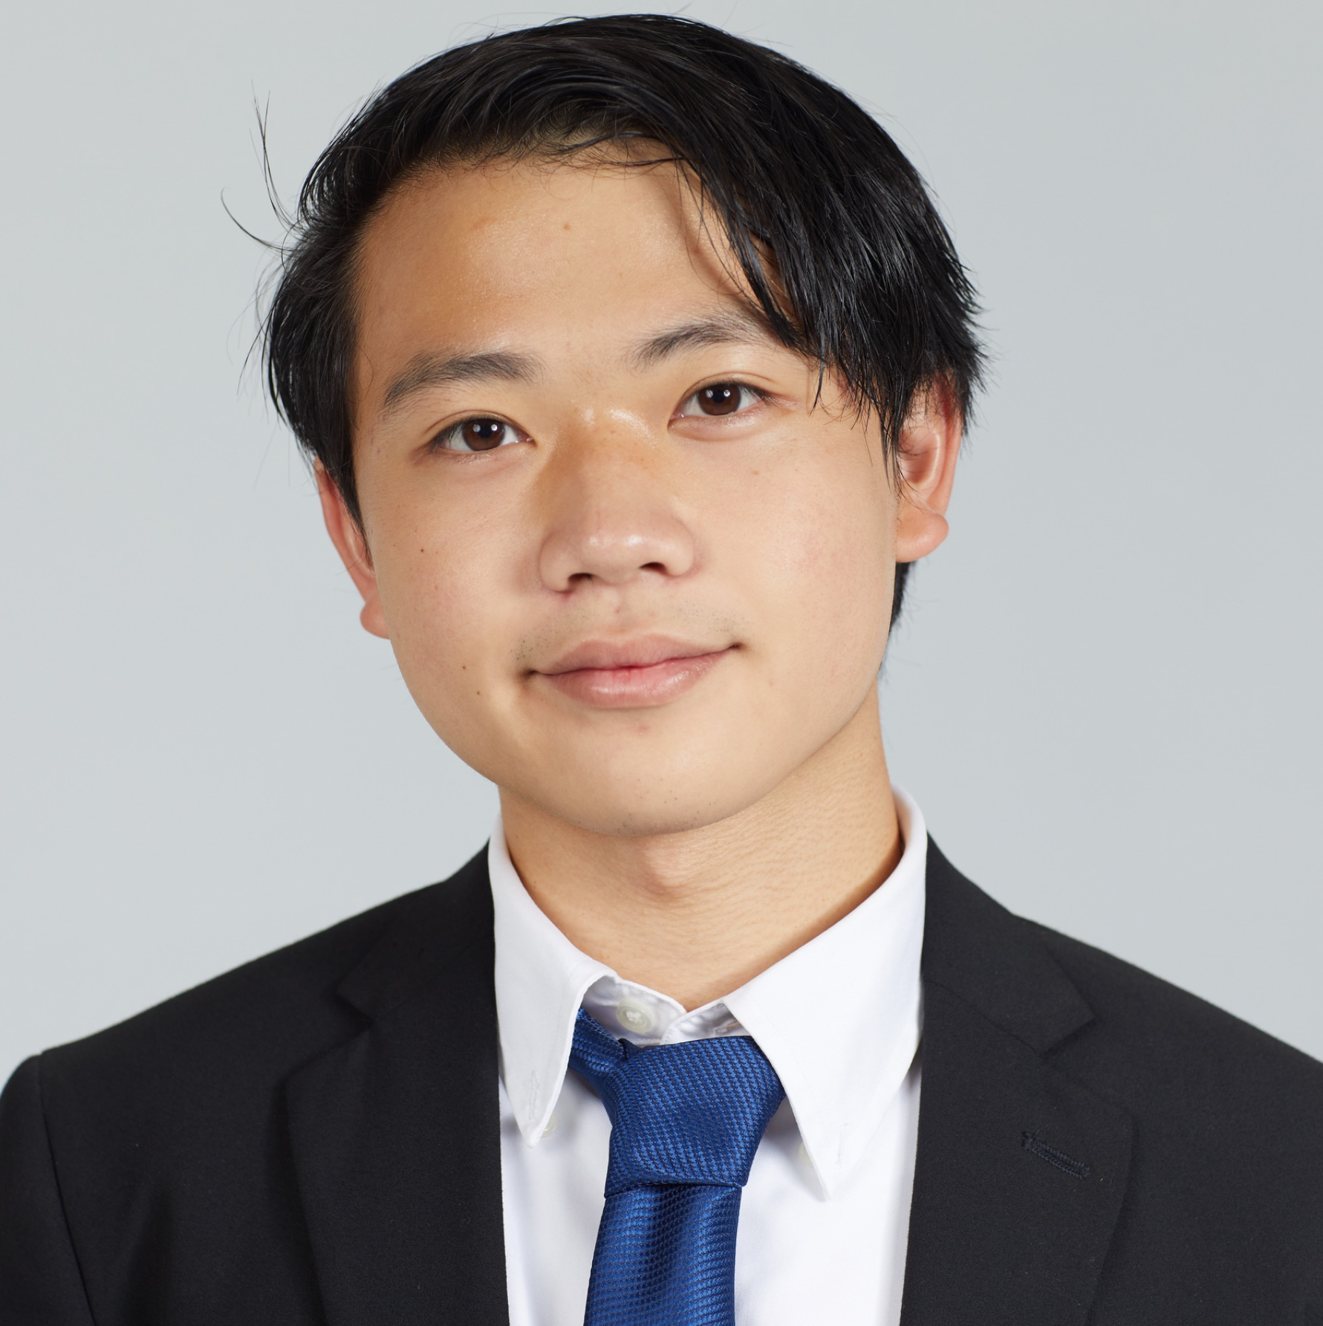

Meet the Team!
Takumi Fukuzawa
Maryland
Sadman Islam
Connecticut
Maisha Iqbal
Alabama
Glenn Todd
Pennsylvania
Robert Yamasaki
California
Notes:
maisha

Slide 4
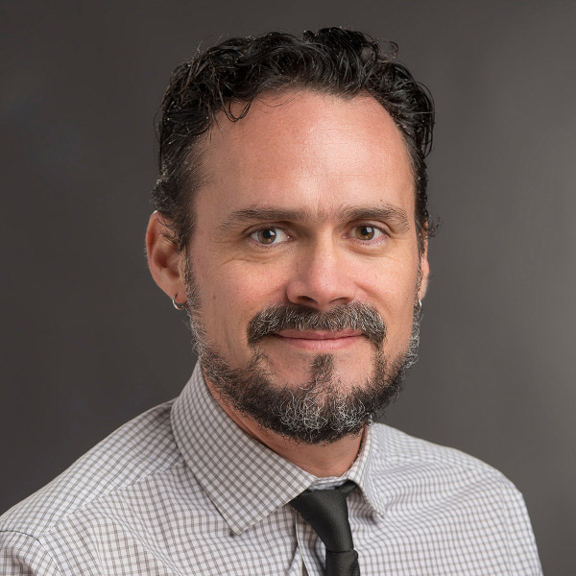
Meet our Coach!
Kenn Martinez
Senior Lecturer Department of Software Engineering
Notes:
maisha

Slide 5
Table of contents
01
02
03
The Start
Current State
Reflection & Future
The original goals, constraints, and milestones behind the project.
The current progress of the project, including key features that have been implemented
Reflection on what we’ve learned and what the future could look hold for this project
Notes:
maisha

Slide 6
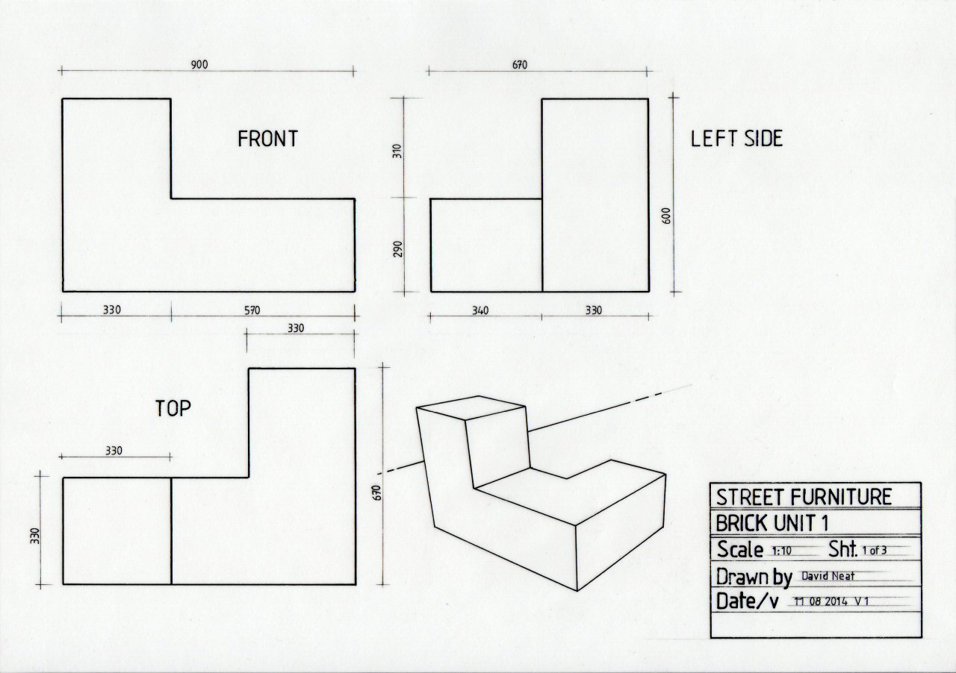
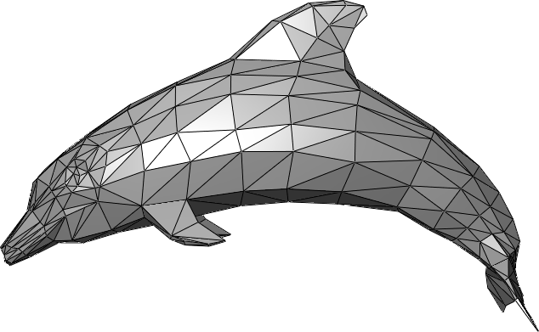
Core Definitions
Technical Drawing (2D)
Detailed diagram that explains how an object is created or functions
Mesh Model (3D)
A 3D representation of an object
Uses a collection of vertices, edges, and faces to define its shape
Voxel
3D Representation of a pixel
https://en.wikipedia.org/wiki/Polygon_mesh
https://davidneat.wordpress.com/technical-drawing/some-of-the-principles-of-technical-drawing-simply-illustrated-part-1/
Notes:
sadman

Slide 7
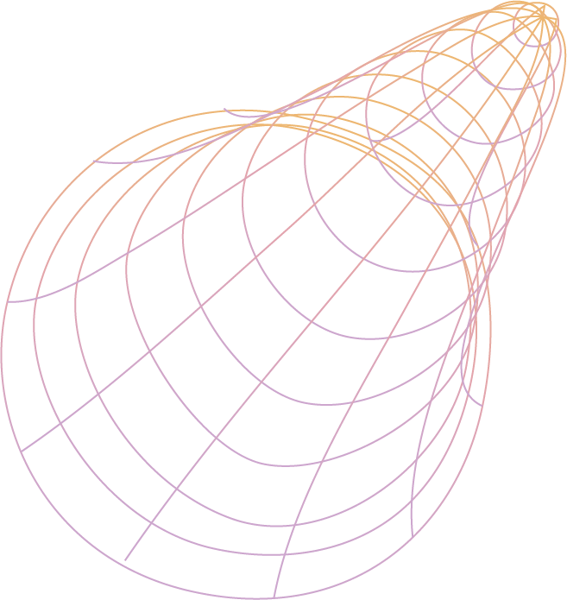
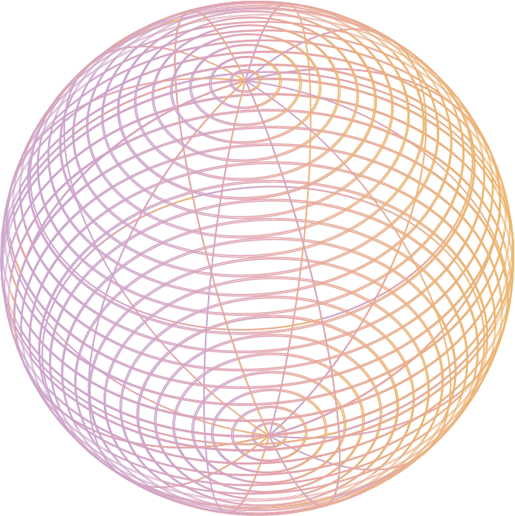
01
The Start
The original goals, constraints, and milestones behind the project.
Notes:
sadman

Slide 8
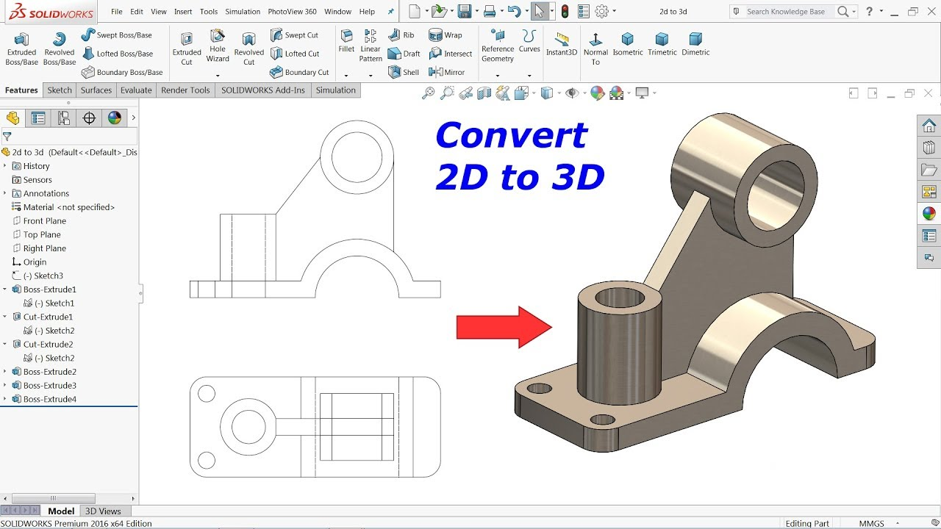
Why?
Technical drawings are common in communicating design
Can have differences based on industry
Converting 2D drawings to 3D models is manual, time-consuming, and requires expert knowledge.
https://www.youtube.com/watch?v=w04H_7AzixE
Notes:
sadman

Slide 9

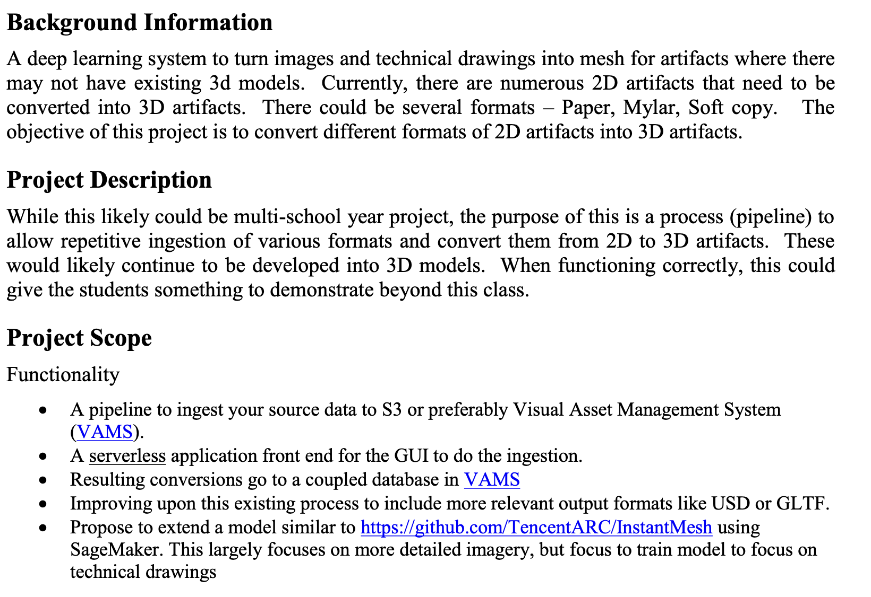
Original Proposal
Deep learning system that turns Technical Drawings into 3D mesh models
Formats: Paper, Mylar, and Soft Copy
Utilize AWS
VAMS, S3, SageMaker, Lambda
Serverless Front-End GUI
Notes:
sadman

Slide 10
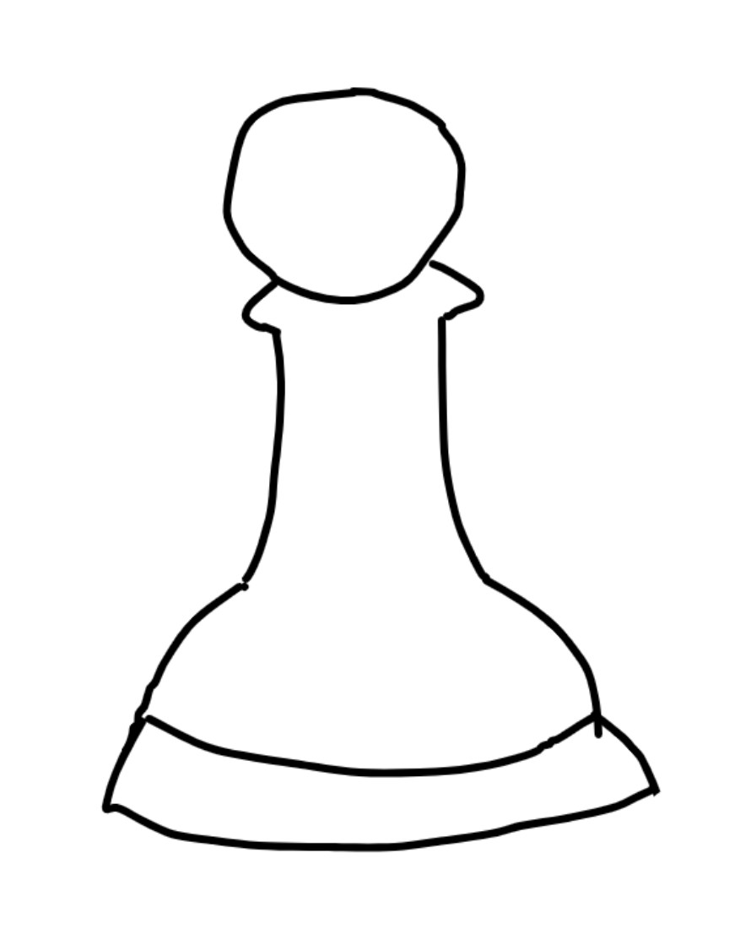
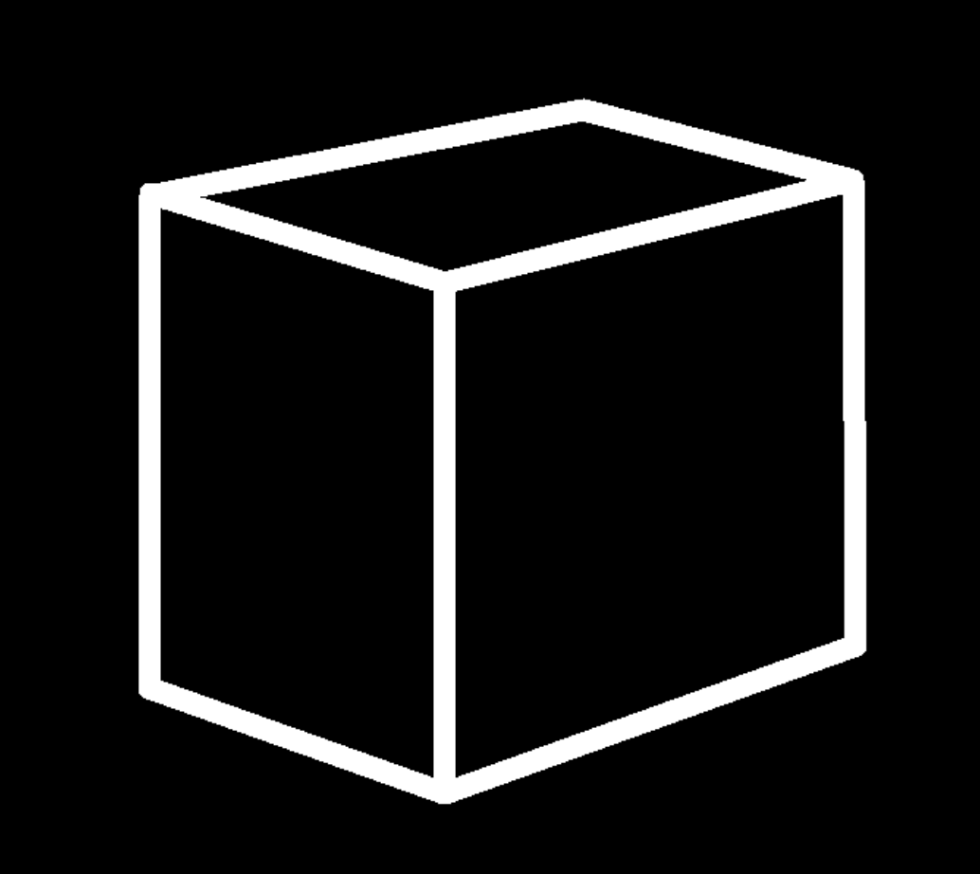
Project Scope
AI Model
Can perform basic sketch to object, disregard input type
Serverless Front-End GUI that can create & view models
Using AWS to host
Notes:
takumi

Slide 11
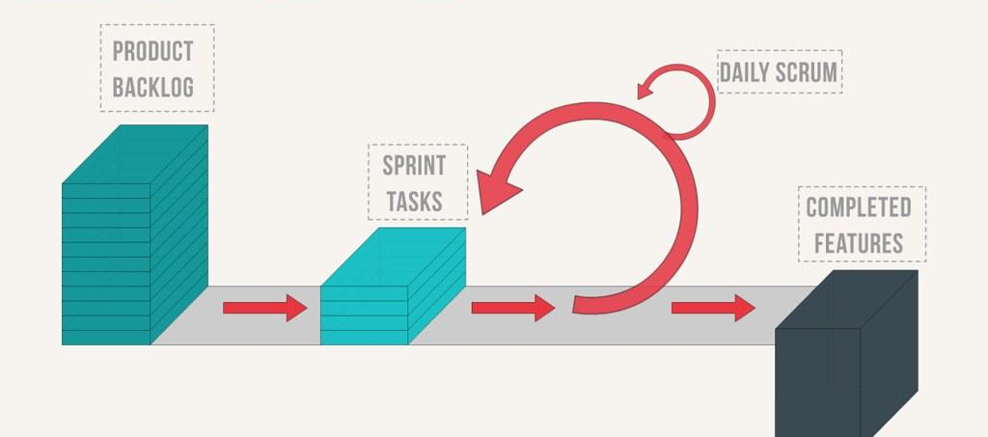
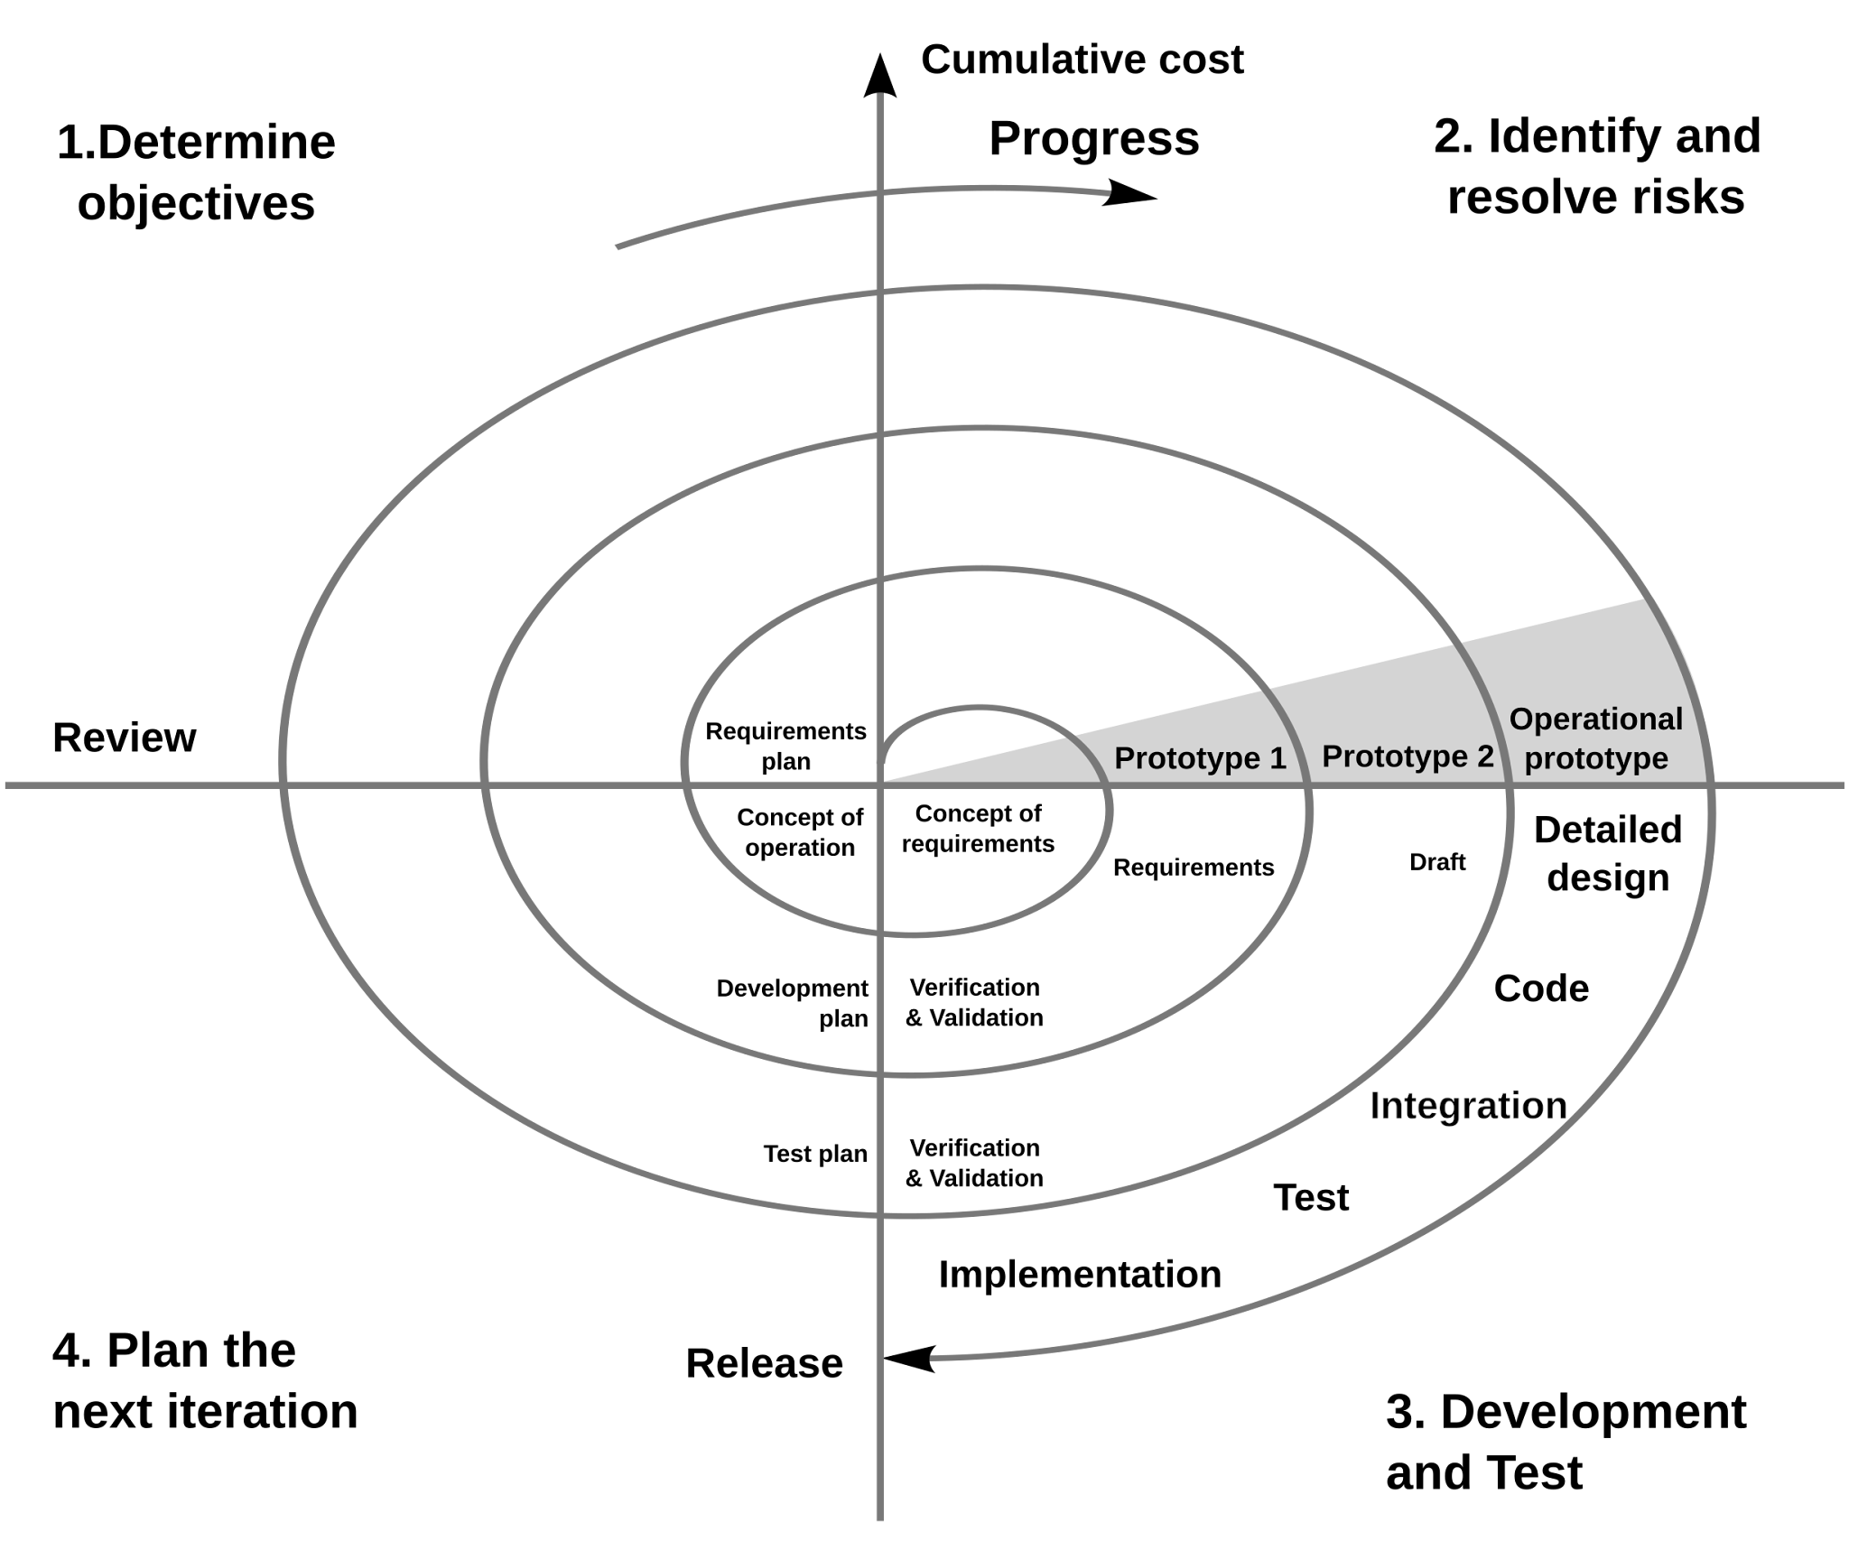
Methodology
Emerging AI field with limited research or public code which led to our methodology
Experimental nature of project required a flexible development approach
Adopted a modified Scrum process incorporating Spiral model principles
Emphasized continuous risk assessment
Proactively identified and mitigated potential sources of downtime
Notes:
takumi

Slide 12
Initial Research
Notes:
takumi

Slide 13
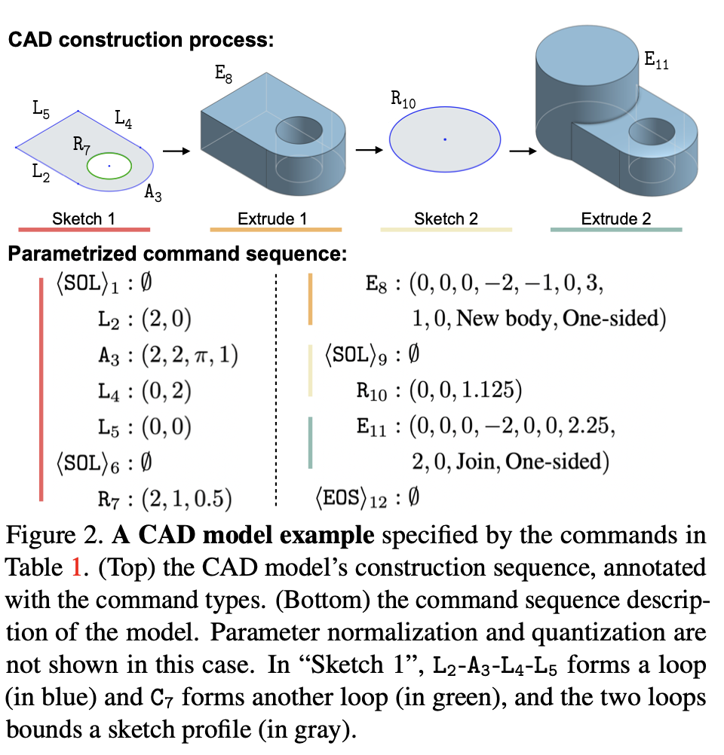
Deep CAD
Published in 2021
This predicted the sequence of computer-aided design (CAD) operations required to recreate on object based on a sketch
Unfortunately, this wasn’t what we were looking for.
Wu, R., Xiao, C., & Zheng, C. (2021). DeepCAD: A deep generative network for computer-aided design models. 2021 IEEE/CVF International Conference on Computer Vision (ICCV), 6752–6762. https://doi.org/10.1109/iccv48922.2021.00670
Notes:
takumi

Slide 14
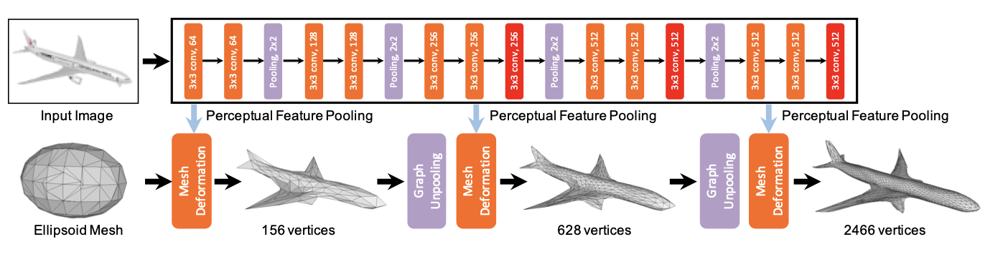
Pixel2Mesh
Utilizes a single RGB image of an object
Mesh deformation
Start with an Ellipsoid Mesh that progressively gets altered by adding more and more vertices taking advantage of pooling layers
Focused on the improvement of quality of an low quality mesh
Our input differs & their method focuses on refining rather than generating them from scratch
Wang, N., Zhang, Y., Li, Z., Fu, Y., Liu, W., & Jiang, Y.-G. (2018). Pixel2Mesh: Generating 3D Mesh Models from Single RGB Images. arXiv [Cs.CV]. Retrieved from http://arxiv.org/abs/1804.01654
Notes:
takumi

Slide 15
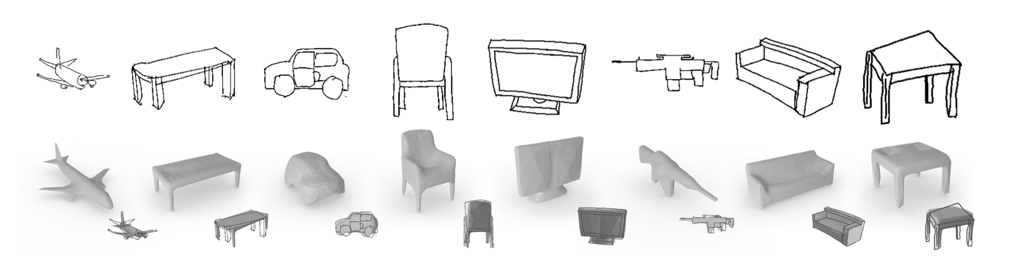
Sketch2Model
Generates 3D meshes from single free-hand sketches and aims to resolve sketch ambiguities
This approach learns the features of objects from sketches, despite quality
But, it requires object-specific training.
Ex. To get good results for planes, the model must be trained only on planes.
No general model to handle object generation across multiple different object categories
Zhang, S.-H., Guo, Y.-C., & Gu, Q.-W. (2021). Sketch2Model: View-Aware 3D Modeling from Single Free-Hand Sketches. arXiv [Cs.CV]. Retrieved from http://arxiv.org/abs/2105.06663
Notes:
takumi

Slide 16
02
Current
The current progress of the project, including key features that have been implemented.
Notes:
glenn

Slide 17
Cloud and Serverless GUI
Notes:
glenn

Slide 18





Cloud Resources
API Gateway
API Gateway allowed us trigger our Lambda function with user uploaded input files
Lambda
Within our lambda, we have an integration script that hits both of our models to convert the user input into a 3D model
Sagemaker
We have two models currently hosted on Sagemaker, our VQVAE and Maskgit models.
VAMS
VAMS (Virtual Asset Management System) is our database system for storing visual assets.
Cloudformation
Cloudformation is acting as our infrastructure tool, allowing us to make quick changes to existing resources
Notes:
glenn

Slide 19
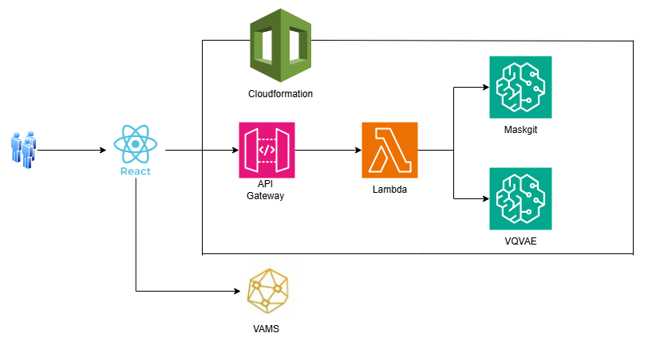
Cloud Architecture
Notes:
glenn

Slide 20
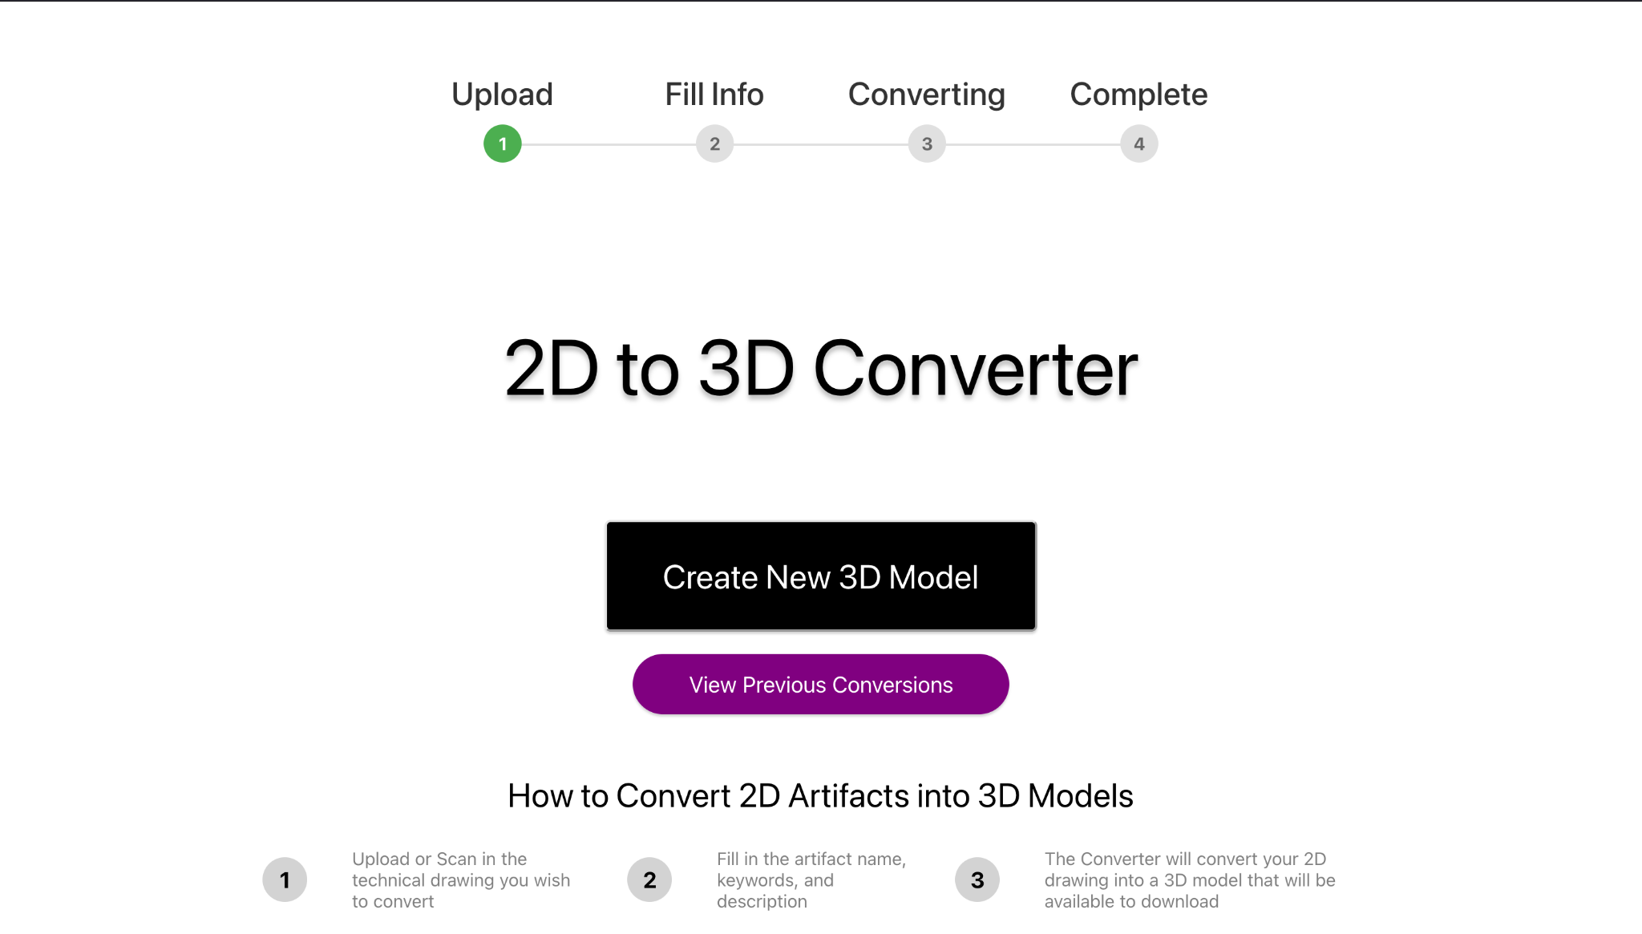
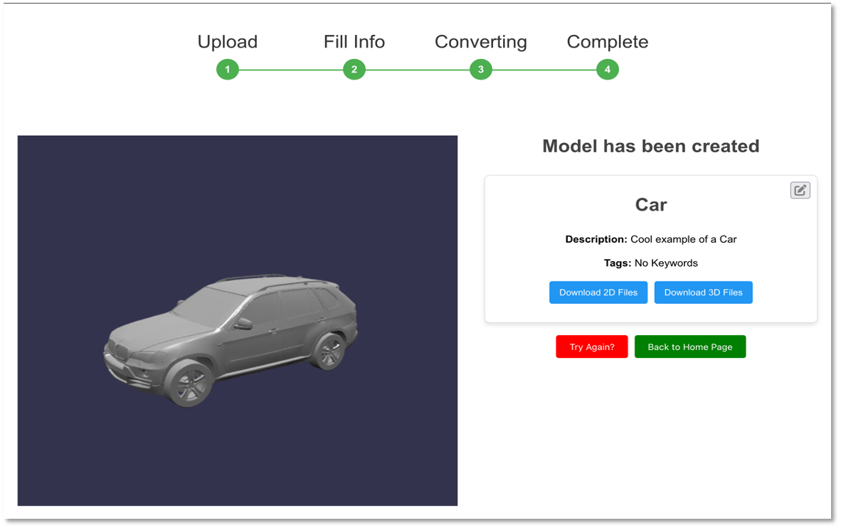
Serverless GUI
Serverless, user-friendly GUI
Front end has:
VAMS integration
3D visualizer
History log
Development paused to prioritize the AI model
Notes:
maisha

Slide 21
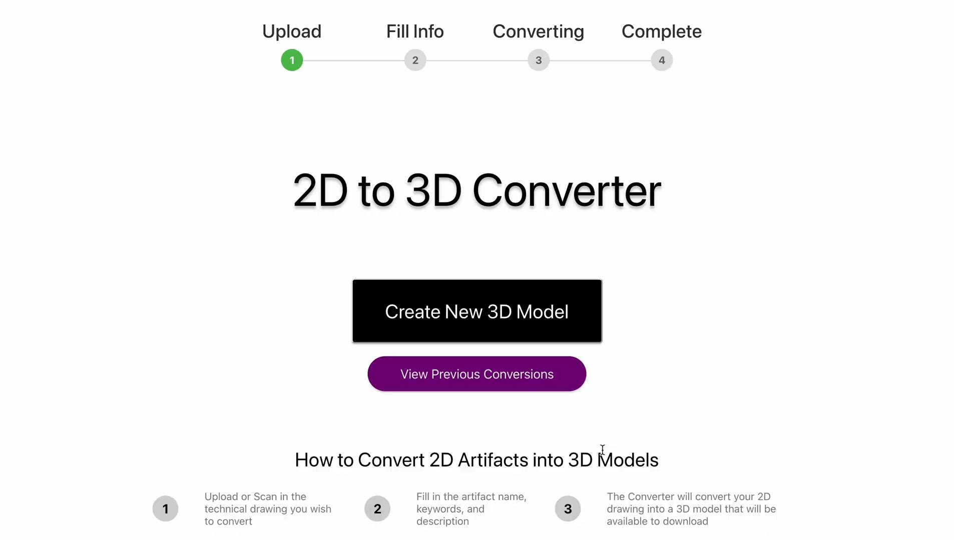
Notes:
maisha

Slide 22
AI Model
Notes:
maisha

Slide 23
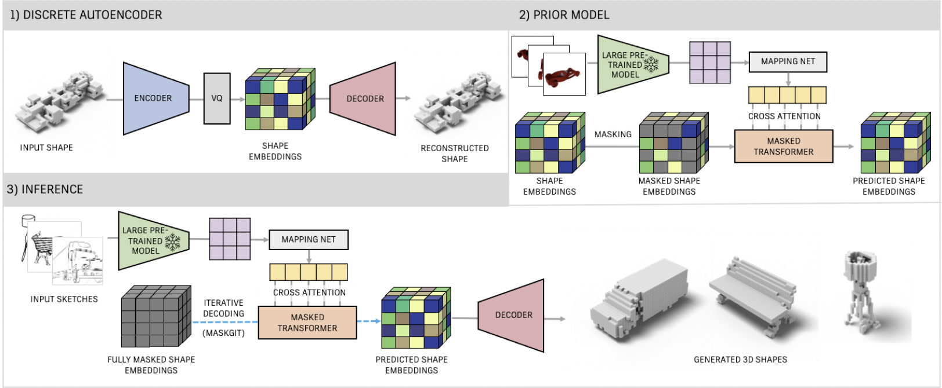
Sketch-A-Shape
Published in 2023, presents a method to generate 3D shapes from sketches using features from three AI models. But there is no public code → develop from scratch
Vector Quantized Variational Autoencoder(VQ-VAE)
Contrastive Language-Image Pretraining (CLIP)
Masked Generative Image Transformer (MaskGit)
Sanghi, A., Jayaraman, P. K., Rampini, A., Lambourne, J., Shayani, H., Atherton, E., & Taghanaki, S. A. (2023). Sketch-A-Shape: Zero-Shot Sketch-to-3D Shape Generation. arXiv [Cs.CV]. Retrieved from http://arxiv.org/abs/2307.03869
Notes:
maisha

Slide 24
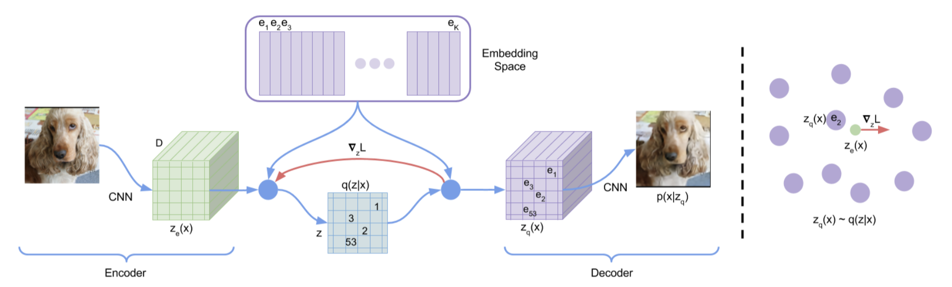

Vector Quantized Variational Autoencoder(VQ-VAE):
An encoder-decoder model by Google DeepMind
Compresses 2D images into a discrete latent space, capturing key visual features for efficient representation and generation.
In our work, it is adapted to learn the features of 3D voxel shapes
van den Oord, A., Vinyals, O., & Kavukcuoglu, K. (2018). Neural Discrete Representation Learning. arXiv [Cs.LG]. Retrieved from http://arxiv.org/abs/1711.00937
Notes:
robert

Slide 25
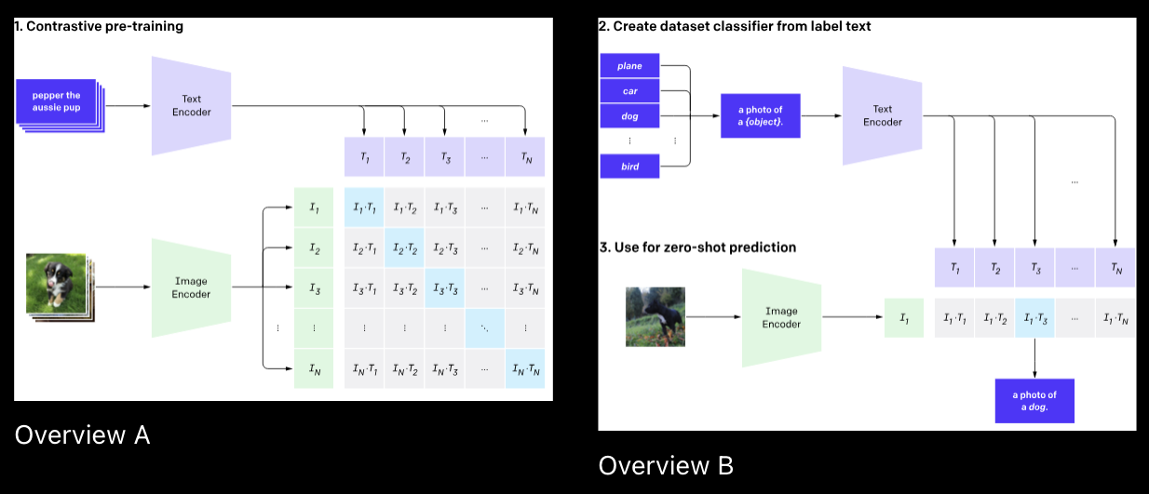

Contrastive Language-Image Pretraining (CLIP)
A neural network from OpenAI that learns visual concepts from natural language
Designed for zero-shot learning, enabling other models to use its knowledge for various vision-tasks without additional training.
We only use the Vision Transformer part of this model to get key features from a 2D image
Radford, A., Kim, J. W., Hallacy, C., Ramesh, A., Goh, G., Agarwal, S., … Sutskever, I. (2021). Learning Transferable Visual Models From Natural Language Supervision. arXiv [Cs.CV]. Retrieved from http://arxiv.org/abs/2103.00020
Notes:
robert

Slide 26
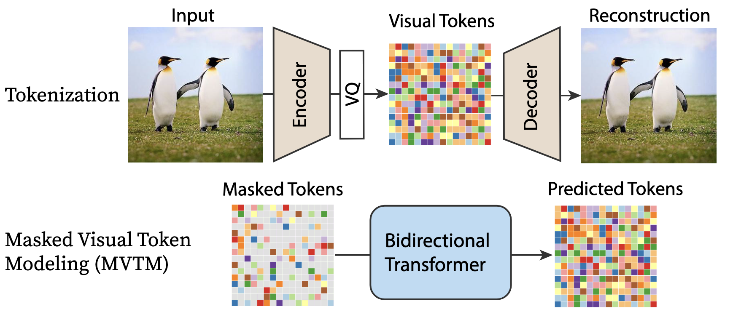

Masked Generative Image Transformer (MaskGit)
A bidirectional transformer model by Google Research that predicts masked tokens in a discrete latent sequence.
Originally used for 2D image synthesis, it is adapted to generate VQ-VAE shape indices for efficient and high-quality 3D shape generation through iterative refinement
Chang, H., Zhang, H., Jiang, L., Liu, C., & Freeman, W. T. (2022). MaskGIT: Masked Generative Image Transformer. arXiv [Cs.CV]. Retrieved from http://arxiv.org/abs/2202.04200
Notes:
robert

Slide 27
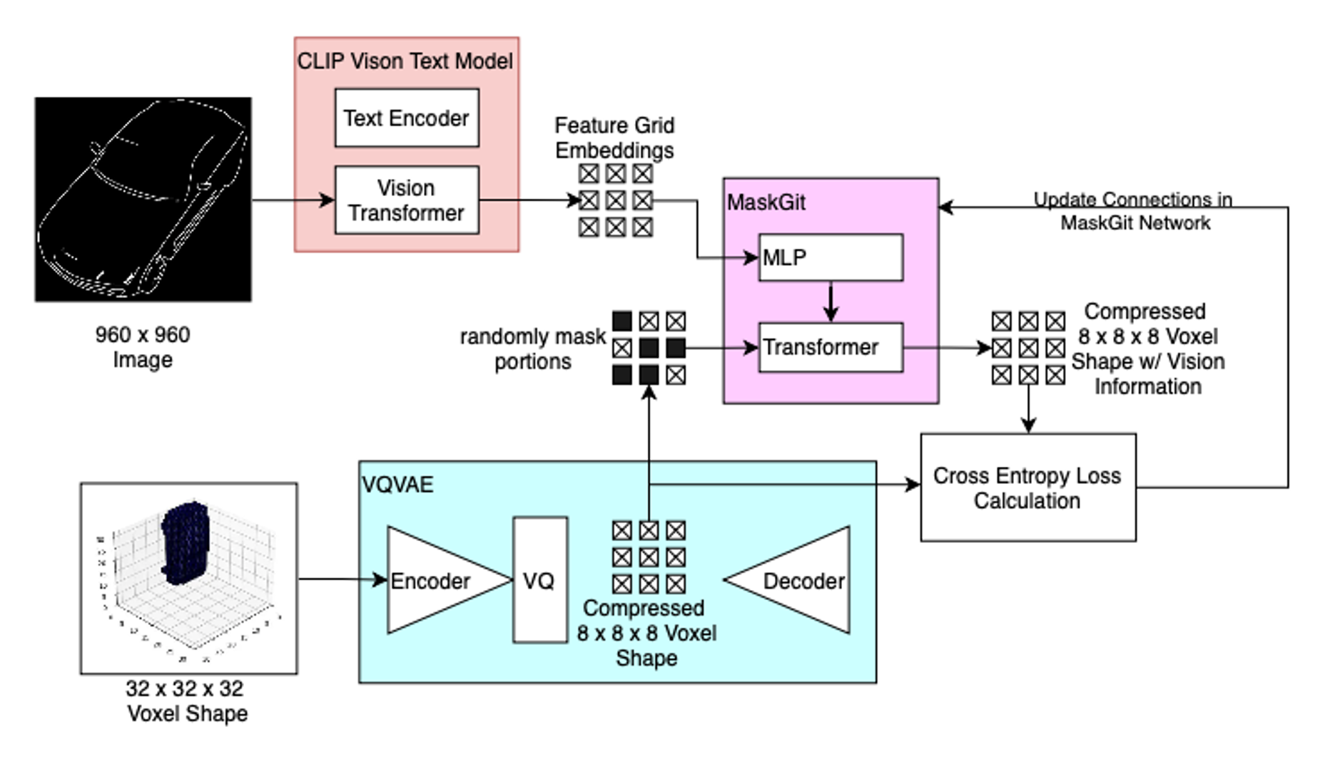
Training Procedure
During training, the model has access to both the 3D shape and its corresponding sketches from 7 viewpoints.
The MaskGIT model learns to reconstruct masked portions of the compressed shape—produced by the VQ-VAE—using feature embeddings extracted from CLIP.
Notes:
Robert
** VQVAE is trained before hand

Slide 28
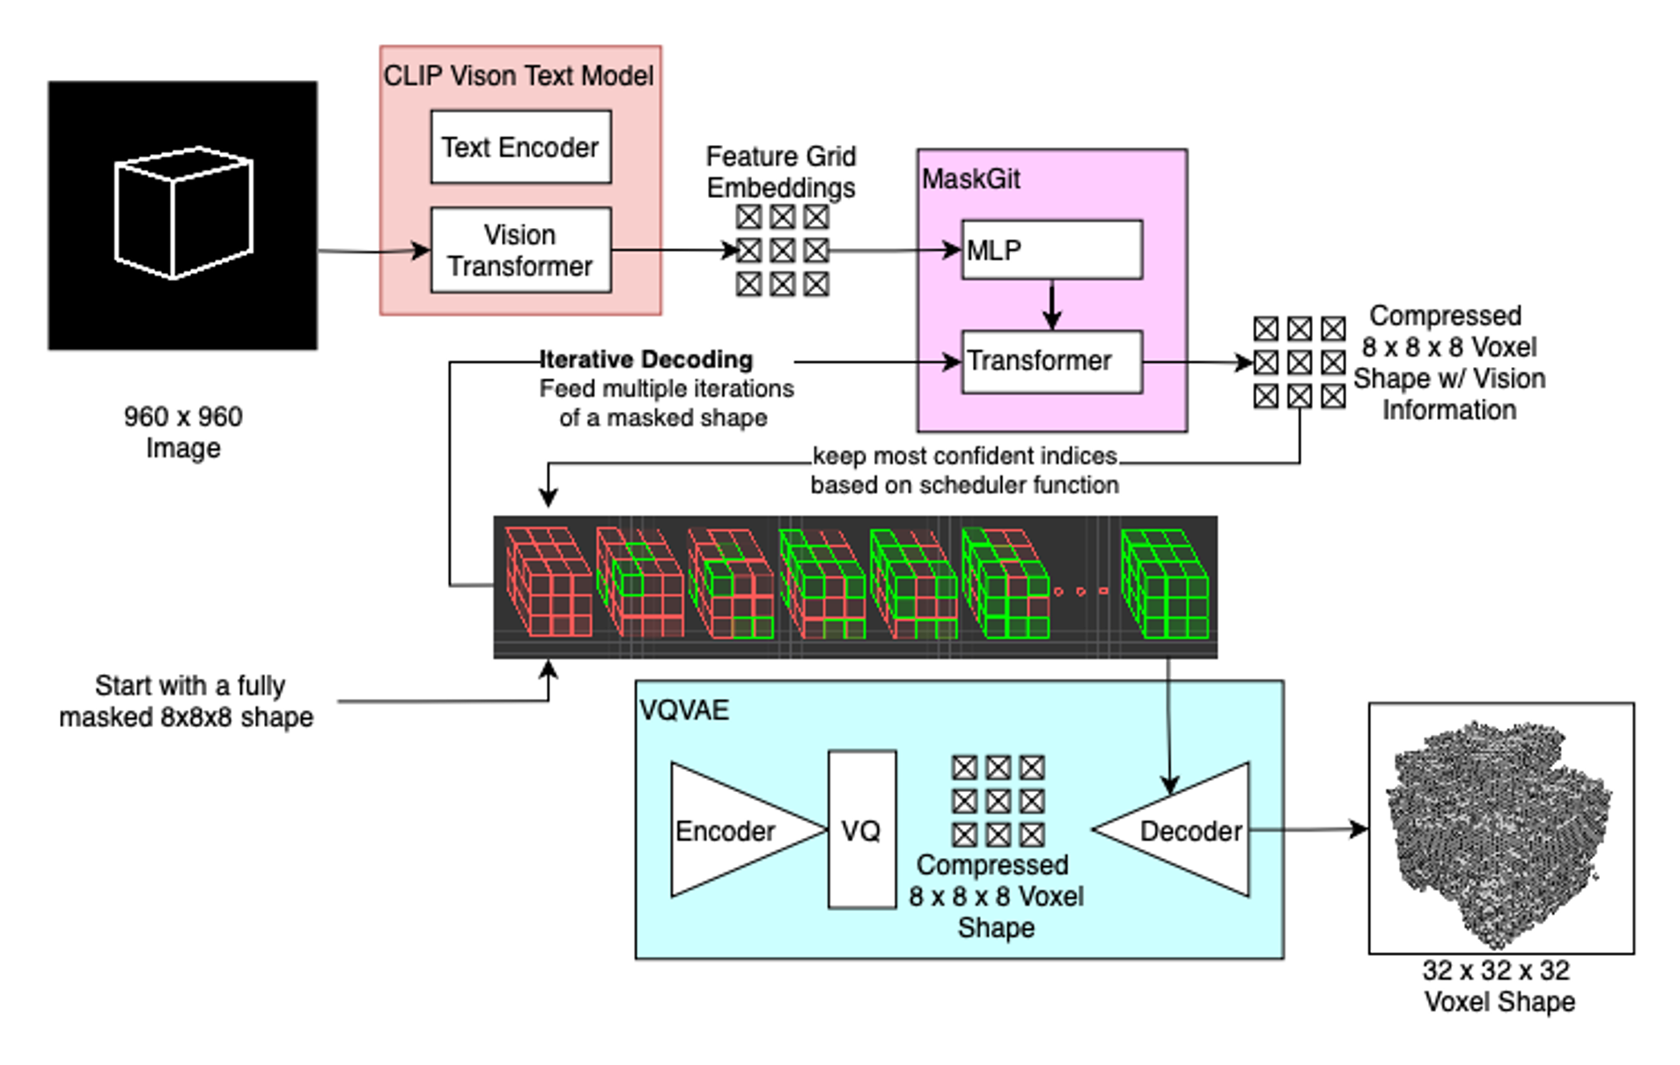
Inference Process
During inference, only the sketch is available because 3D model is unknown.
The MaskGIT begins with a fully masked compressed shape and iteratively filling in shapes indices based on the features from CLIP until a confident prediction is formed.
This completed representation is then passed through the decoder to generate the 3D shape.
Notes:
robert

Slide 29
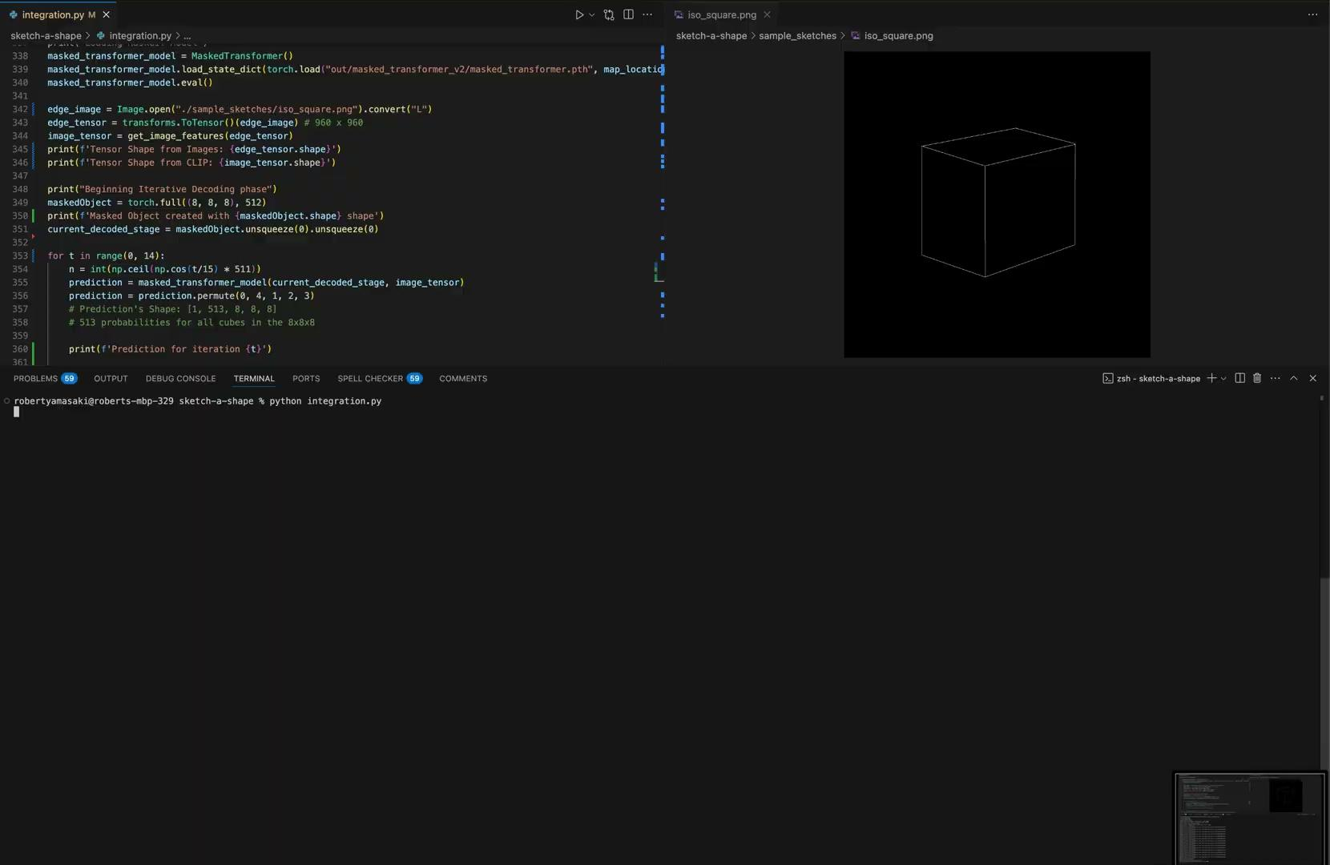
Notes:
robert

Slide 30
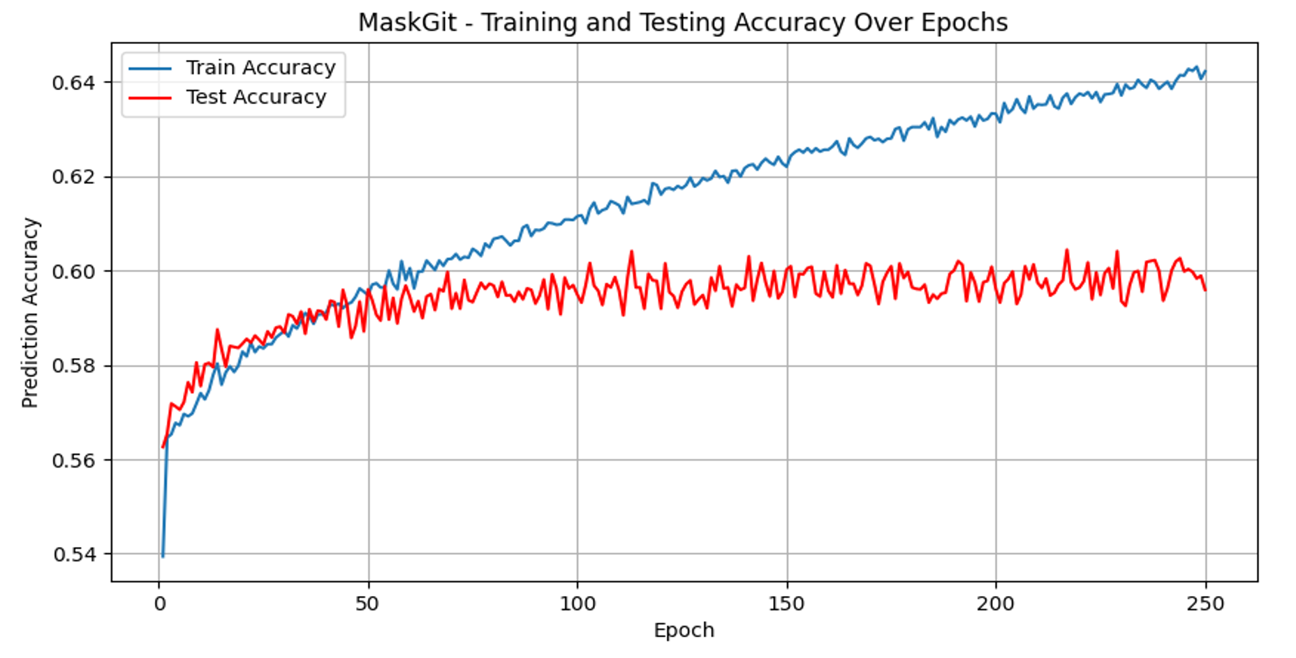
Model Accuracy
During training, the model (MaskGit) predicts 64% of the associated indices correctly on the training dataset.
The accuracy on the test dataset remains around 60% providing indication that the model is overfit.
Notes:
robert

Slide 31
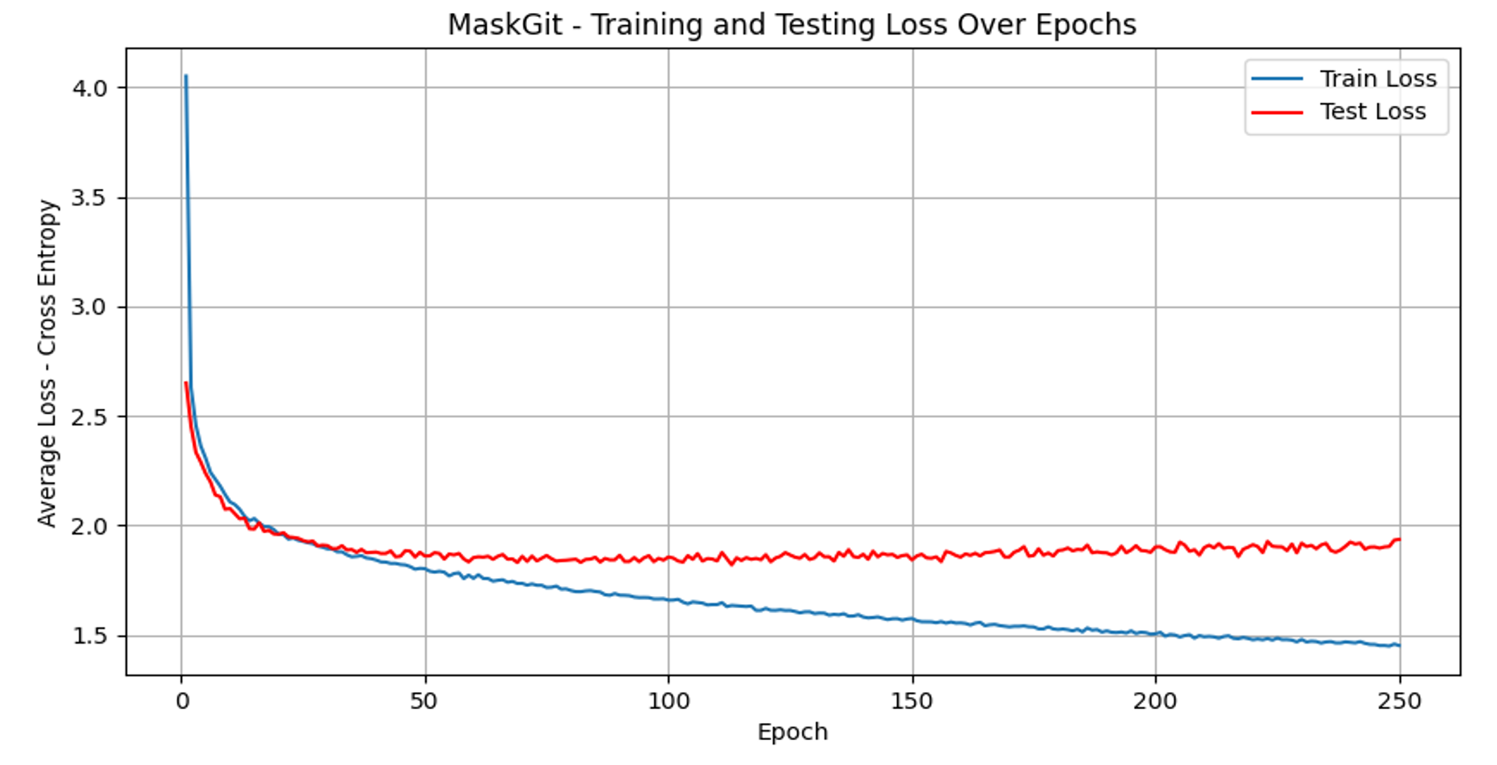
Loss Analysis
Cross-entropy loss measures the model’s (MaskGit) confidence in predicting the correct VQVAE indices that are representative of the original shape.
The gap between training and test loss curves shows our model is overfitting, performing much better on the training data.
Notes:
robert

Slide 32
03
Reflection & Future
Reflection on what we’ve learned and what the future could look hold for this project
Notes:
glenn

Slide 33
Future
Possible improvements for all parts of the project
Notes:
glenn

Slide 34
Serverless GUI & Cloud
Serverless GUI
Better design
Both aesthetically and with the code
Addition of being able to scan in images using a camera
Fix defects
Ex. Key words (Tags)
Hosting on the Cloud
Host a separate SageMaker model to handle CLIP
Create Lambda container to avoid Lambda layer size constraints
Notes:
Glenn + maisha

Slide 35
Model Improvements
Training Infrastructure
The model was trained on local machines for over 300 hours.
Future teams can leverage AWS SageMaker for faster training times.
Dataset Expansion
MaskGIT utilized more data (24 views of an object) when training their model
We didn’t due to memory concerns but Increasing the number of views may enhance model performance
Image Resolution
Sketches were generated at an arbitrary resolution of 960×960 pixels.
Lower resolution images on model accuracy may yield gains.
Notes:
takumi

Slide 36
Model Improvements
Sketch Simplification:
Some sketches contained excessive detail, potentially hindering the model's learning process.
Text Input:
Additional information with the cross attention mechanism may potentially enrich the model’s understanding.
Ex. Tell the model that the technical drawing that is being inputted is a plane.
Notes:
takumi

Slide 37
Reflection
Reflection on the year
Notes:
sadman

Slide 38
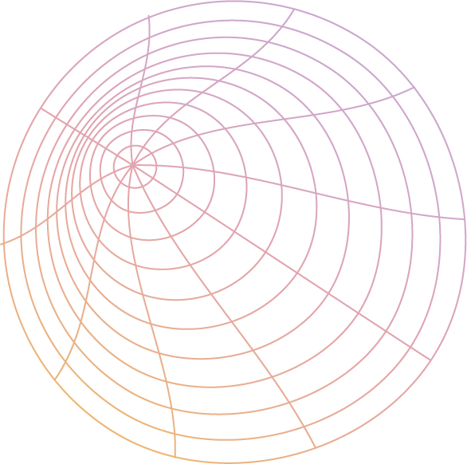
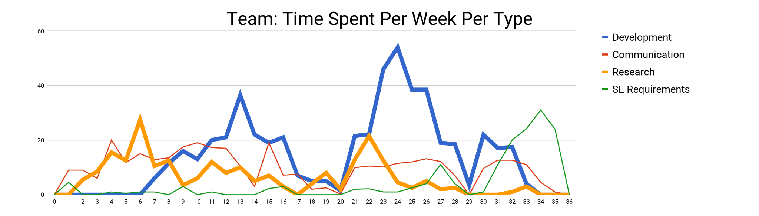
Time Spent
Started off with Research and ended with Development
Total: ~ 1,260 hours
VQVAE Implementation
GUI Development
MaskGIT
Implementation
MaskGIT Implementation
Research
Explorative research
Video
Poster
Technical Report
Retrospective Doc
Notes:
sadman

Slide 39
Lessons Learned
All commitments take longer than you originally expect it to
Data drives all AI development
“Fail Early and Fail Fast”
Notes:
maisha

Slide 40
Thank you to….
Jaime Wightman
Brian Kelly
Brian Nevinsky
Sterling Belleau
Bill Norris
Kristian Hovland
Alaina Bradley
and everyone else that helped us!
Notes:
maisha

Slide 41
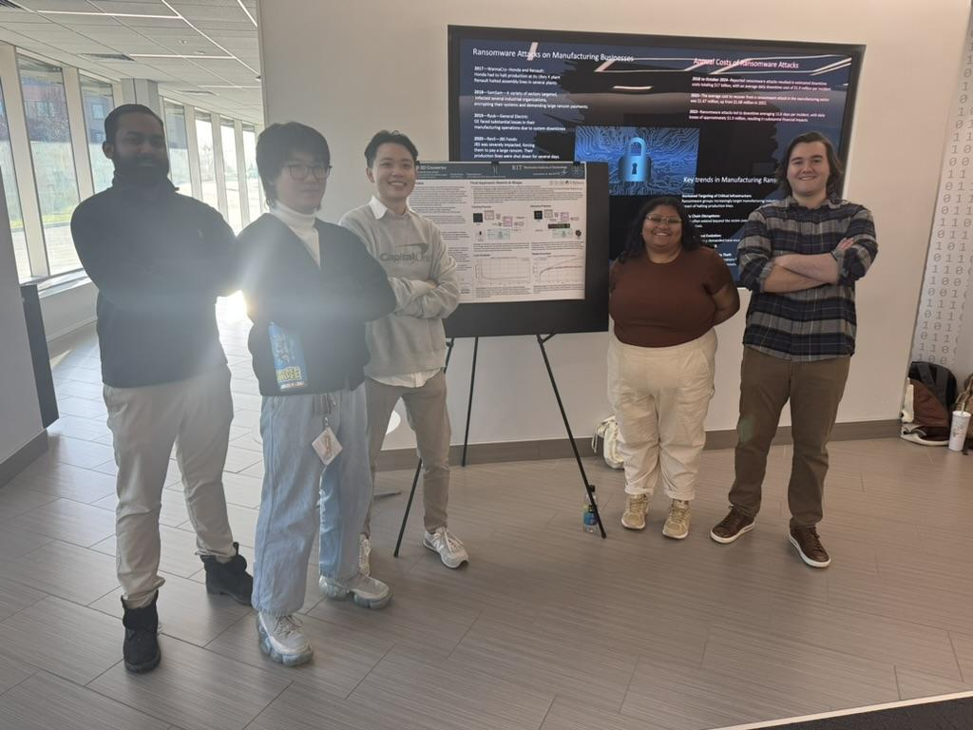
Any questions, comments, or concerns?
Notes:
maisha

